Slide 1
M O D U L E - 4

Slide 2
CODING

Slide 3
INTRODUCTION
Coding is done after the design phase is complete and design document is reviewed successfully
Every module specified in design document is coded and unit tested
In unit testing, each module is tested individually when its coding is complete
Objective of coding phase
Transform the design of a system into a code, using a high level language and then unit test this code

Slide 4
Introduction [2]
Input to coding phase is design document
Design document contains
High level design (preliminary) in the form of structure chart
Detailed design in the form of module specification (MSPEC)
During coding phase, different modules identified in design document are coded according to MSPEC

Slide 5
CODING PRINCIPLES AND CONCEPTS
The principles that guide the coding task are closely aligned with
Programming style
Programming languages
Programming methods
Fundamental coding principles are:-
Preparation principles
Coding principles
Validation principles

Slide 6
Preparation principles
Before writing a line of code, we have to ensure the following
Understand of the problem
Understand basic design principles and concepts.
Pick a programming language
Select a programming environment

Slide 7
Coding principles
As the coding proceeds following things are ensured:
Check your algorithms
Select data structures
Understand the software architecture and create interfaces that are consistent with it.
Keep conditional logic as simple as possible.
Create nested loops in a way that makes them easily testable.
Select meaningful variable names and follow other local coding standards.
Write code that is self-documenting.
Create a visual layout (e.g., indentation and blank lines) that aids understanding.

Slide 8
Validation principle
After completing the coding, following things are conducted:
Conduct a code walkthrough when appropriate.
Perform unit tests and correct errors you’ve uncovered.
Refactor the code.

Slide 9
CODING STANDARDS & GUIDELINES
A good s/w development organization require their programmers to follow some well defined coding style
This well defined & std style of coding is called as coding standards
Every organization formulate their own coding standards
Coding standard lists several rules to be followed during coding
Eg: naming of variables, error returning conventions etc

Slide 10
Advantages of using coding standards
Gives a uniform appearance to the codes written by different engineers
Facilitates code understanding and code reuse
Promotes good programming practices

Slide 11
Effects of coding standards
It is mandatory for the programmers to follow coding standards prescribed by the company
Complaint of the code with the coding std is verified during code inspection
Code that does not follow the coding std is rejected during code review
Then the code has to be re-worked by the programmer

Slide 12
GENERAL CODING STANDARDS
Representative coding standards
Rules for limiting the use of global
These rules list what type of data can be declared as global and what cannot
This limits the data to be declared as global
Standard headers for different modules
The header of different module should have a std format
This facilitates ease of understanding and maintenance

Slide 13
General Coding standards
Eg: for Header format
Name of the module
Date of creation of module
Authors name
Modification history
Synopsis of module
It is a write-up about what a module does
Different functions supported in the module along with i/p - o/p parameters
Global variables accessed/modified by the module

Slide 14
General Coding standards
Naming conventions for local and global variables & constant identifiers
Variables are named using mixed case lettering
Global variable name always start with capital letter
Eg: GlobalData
Local variable name always start with small letter
Eg: localData
Constants are formed using capital letters only
Eg: CONSTDATA

Slide 15
General Coding standards
Conventions regarding error return values and exception handling
The way in which error conditions are reported by different functions in a program should be standardized
Eg: all functions encountering an error must return either a 0 or 1 consistently independent of the programmer who wrote the code
This facilitates reuse & debugging

Slide 16
CODING GUIDELINES
Coding guidelines are also prescribed by companies
They provide general suggestions regarding the coding style to be followed
Actual implementation of these guidelines are the discretion of developers

Slide 17
General coding guidelines
Do not use coding style that is too clever or too difficult to understand
Code must be easy to understand
Clever coding may reduce code understandability
This make maintenance & debugging expensive

Slide 18
General coding guidelines
Avoid obscure side effects
Side effects of a function call are:-
Modifications of parameter passed by reference
Modification of global variables & I/O operations
An obscure side effect is the one that cannot be identified from casual examination of the code
This makes difficult to understand the code

Slide 19
General coding guidelines
Do not use an identifier for multiple purposes
Programmers often use same identifier to denote several temporary entities
Problems arises when same variable are used for multiple purposes
If an identifier is used for multiple purpose, it cannot be given a descriptive name that indicates its purpose
Lead to confusion
Difficult to understand or read the code
Make future enhancements difficult

Slide 20
General coding guidelines
Code should be well documented
There should be at least one comment line on an average of 3 source lines of code
Length of a function should not exceed 10 source lines
Lengthy function is difficult to understand
They are likely to have large no: of bugs
Do not use GO TO statements
This makes the program unstructured
Difficult to understand, debug and maintain

Slide 21
C O D E R E V I E W

Slide 22
Introduction
Effective technique to remove defects from source code
Cost effective way for removing defects compared to testing
Done after a module is successfully compiled

Slide 23
TYPES OF CODE REVIEW
Code walkthrough
Code inspection
Procedures and final output of these two are different

Slide 24
Code walkthrough
Informal code analysis technique
A module is taken for review after coding and compiling it successfully
Few members of development team are given the code, few days before walkthrough meeting
Each member take a test case and simulates the execution of code manually
Traces the execution of code
Objective
Discover algorithmic and logical errors in the code

Slide 25
Code walkthrough
Members note down their findings after the walkthrough
Discuss these findings in the walkthrough meeting where coder is also present
Guidelines for walkthrough meeting
Team performing walkthrough meeting should not be too large or too small
3 to 7 members
Discussion focus on discovery of errors
Avoid deliberations on how to fix those errors
Managers should not attend the meeting
This is to provide cooperation and avoid feelings among engineers who are being evaluated during the meeting

Slide 26
Code inspection
Code is examined for the presence of common programming errors
Objective
Check for the presence of common programming errors
Check whether code adheres to coding standards

Slide 27
Advantages of code inspection
Programmer receives feedback on
Programming style
Choice of algorithms
Programming techniques
s/w companies collect statistics regarding different types of commonly committed errors
List of these errors are used as checklist

Slide 28
Classical programming errors checked during code inspection
Use of un-initialized variable
Non terminating loops
Incompatible assignments
Array indices out of bound
Improper modification of loop variables etc

Slide 29
Clean room testing
Pioneered at IBM
Type of testing which relies on
Walkthrough
Inspection
Formal verification
Programmers are not allowed to test their code by executing it other than doing some syntax testing using a compiler
Technique produces documentation and code that is more reliable and maintainable
Problems
Testing effort is increased

Slide 30
SOFTWARE DOCUMENTATION
When a software is developed, in addition to executable files and source code, certain documents are also developed
Users manual
SRS document
Design document
Test document
Installation manual

Slide 31
Purpose of good documents
Enhance understandability of code
Reduce effort & time for maintenance
Helps the users to understand and effectively use the system
Effectively tackle manpower turnover problem
When an engineer leaves the organization and a new engineer comes in, he can build up knowledge easily by referring the documents
Helps the managers to track the progress of the project

Slide 32
Types of software documents
Internal documents
Provided in the source code itself
External documents
Supporting documents such as
SRS
User manual
Installation document
Design document
Test document

Slide 33
Internal documentation
It is the code comprehension features provided in source code itself
Types of internal documentations
Comments embedded in source code
Meaningful variable names
Code indentation
Code structuring
Use of enumerated types
Use of constant identifiers
Use of user defined data types

Slide 34
Internal documentation [2]
Out of all types of internal documentation, meaningful variable names is most useful while trying to understand a piece of code

Slide 35
External documentation
External documentation is provided through various supporting documents
All documents are to be of good quality
They are produced in an orderly fashion
A good external document should have
code consistency
Inconsistency lead to confusion
Documents should be up to date
Every change made to code should be reflected in the external documents
Proper understandability about the category of users to whom the document is designed
This is done with the help of gunning’s fog index

Slide 36

Gunning’s fog index
Metric used to measure the readability of document
Metric value of a document indicates
the no: of years of formal education a person should have, in order to comfortably understand a document
Eg: fog 12 indicates that a person who has completed his 12th grade can understand the document

Slide 37
Computing gunning’s fog of a document
Fog(D)=0.4*(words/sentences)+% of complex words in the document
Fog index is the sum of two different factors
First factor computes the average no: of words per sentence
This factor indicates that long sentences are difficult to understand
Second factor measures the % of complex words in the document
Syllable is a group of words that can be pronounced independently
Words having more than 3 syllables are complex words

Slide 38
S O F T W A R E T E S T I N G F U N D A M E N T A L S

Slide 39
Introduction
The goal of testing is to find errors
A good test is one that has a high probability of finding an error.
Tests must have certain Characteristics for finding the most errors with a minimum of effort.

Slide 40
Software Testability
Software testability means how easily a computer program can be tested.
The following characteristics lead to testable software.
Operability
Observability
Controllability
Decomposability
Simplicity
Stability
Understandability

Slide 41
Operability
It states that,
“The better it works, the more efficiently it can be tested.”
If a system is designed and implemented with quality in mind,
relatively few bugs will block the execution of tests
allow testing to progress without fits & starts

Slide 42
Observability
It states that
“What you see is what you test.”
Inputs provided as part of testing must produce distinct outputs.
System states and variables must be visible or queriable during execution.
Incorrect output must be easily identified.
Internal errors are to be automatically detected and reported.
Source code must be accessible.

Slide 43
Controllability
It states that
“The better we can control the software, the more the testing can be automated and optimized.”
This property provides following advantages
Software & hardware states and variables can be controlled directly by the test engineer.
Tests can be conveniently specified, automated, and reproduced.

Slide 44
Decomposability
It implies that
“By controlling the scope of testing, we can more quickly isolate problems and perform smarter retesting.”
The software system must be built as independent modules so that it can be tested independently.

Slide 45
Simplicity
It implies that,
“The less there is to test, the more quickly we can test it.”
The program should exhibit
functional simplicity
feature set is the minimum necessary to meet requirements
Structural simplicity
architecture must be modularized to limit the propagation of faults
Code simplicity
coding standard must be adopted for ease of inspection and maintenance

Slide 46
Stability
It implies that
“The fewer the changes, the fewer the disruptions to testing.”
Changes to the software must be infrequent,
They must be controlled when they do occur
Changes should not invalidate existing tests.

Slide 47
Understandability
It implies that
“The more information we have, the smarter we will test.”
The architectural design and the dependencies between internal, external, and shared components must be well understood.
Technical documentation must be
accessible,
well organized,
specific and detailed,
accurate.
Changes to the design are to be communicated to testers.

Slide 48
TEST CHARACTERISTICS
A good test has a high probability of finding an error.
A good test is not redundant.
A good test should be “best of breed”
A good test should be neither too simple nor too complex.

Slide 49
High probability of finding an error
To achieve this goal,
The tester must understand the software
He must attempt to develop a mental picture of how the software might fail.

Slide 50
No redundancy
Testing time and resources are limited.
There is no point in conducting a test that has the same purpose as another test.
Every test should have a different purpose

Slide 51
Good of breed
In a group of tests that have a similar intent, time and resource limitations may lead to the execution of only a subset of these tests
In such cases tests that has the highest likelihood of uncovering a whole class of errors must be used

Slide 52
Neither too simple nor complex
Although it is sometimes possible to combine a series of tests into one test case,
the possible side effects associated with this approach is that it may mask errors.
In general, each test should be executed separately.

Slide 53
SOFTWARE TESTING STRATEGIES

Slide 54
Introduction
Testing strategies integrates software test case design methods into a well planned series of steps
It describes the steps to be conducted as part of testing
It should incorporate
Test planning
Test case design
Test execution
Resultant data collection
Evaluation
It provides a road map that describes the steps to be conducted as part of testing,
When these steps are planned, and then undertaken, we can calculate effort, time, and resources that will be required

Slide 55
Strategic approach for software testing
Testing is a set of activities that can be planned in advance and conducted systematically.
Strategy provides a template for software testing
A number of software testing strategies have been proposed

Slide 56
Characteristics of testing strategies
Perform effective technical reviews
By doing this, many errors will be eliminated before testing commences.
Testing begins at the component level and works “outward” toward the integration of the entire computer-based system.
Different testing techniques are appropriate at different points in time.
Testing is conducted by the developer of the software and an independent test group.
Testing and debugging are different activities, but debugging must be accommodated in any testing strategy.

Slide 57
Functions of testing strategy
A strategy must accommodate low-level tests & high level tests
Low level tests➔ necessary to verify that a small source code segment has been correctly implemented
high-level tests➔ validate major system functions against customer requirements.
A strategy should provide guidance for the practitioner
Provide set of milestones for the manager.

Slide 58
TESTING STRATEGY FOR CONVENTIONAL SOFTWARE ARCHITECTURE
System engineering
defines the role of software and leads to software requirements analysis, information domain, function, behavior, performance, constraints, and validation criteria for software are established.
Moving inward along the spiral, you come to design and finally to coding.
A strategy for software testing may also be viewed in the context of the spiral

Slide 59
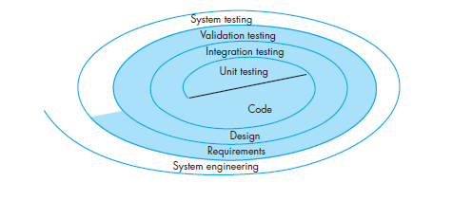

Slide 60
Unit testing begins at the vortex of the spiral
This concentrates on each unit of the software as implemented in source code.
Testing progresses by moving outward along the spiral to integration testing,
The focus is on design and the construction of the software architecture.
Taking another turn outward on the spiral, you encounter validation testing,
where requirements established as part of requirements modeling are validated against the software that has been constructed.
Finally, you arrive at system testing,
where the software and other system elements are tested as a whole.

Slide 61
Unit testing
Makes heavy use of testing techniques
Ensure complete coverage of maximum error detection
Components are assembled to form s/w packages
Integration testing
addresses the issues associated with verification & program construction
After integration a set of higher order tests are conducted
Validation
Validation criteria are evaluated
It provides final assurance that s/w meets functional, behavioral & performance requirements
System testing
After validation, s/w is combined with other elements
Eg: h/w, people, databases
Verifies that all elements mesh properly
Overall s/m function/performance is achieved

Slide 62
TESTING STRATEGY FOR CONVENTIONAL SOFTWARE

Slide 63
Introduction
Many strategies can be used to test software
There are 2 extremes
At one extreme,
you can wait until the system is fully constructed and then conduct tests on the overall system
This approach, although appealing, simply does not work.
It will result in buggy software that disappoints all stakeholders.
At the other extreme,
you could conduct tests on a daily basis, whenever any part of the system is constructed.

Slide 64
A testing strategy that is chosen by many software teams falls between the two extremes.
It takes an incremental view of testing,
testing begins with the testing of individual program units,
moving to tests designed to facilitate the integration of the units (sometimes on a daily basis),
culminating with tests that exercise the constructed system.

Slide 65
UNIT TESTING
Unit testing focuses on verification of the smallest unit of software design,
the software component or module.
Important control paths are tested to uncover errors within the boundary of the module.
It focuses on the internal processing logic and data structures within the boundaries of a component.
This type of testing can be conducted in parallel for multiple components or modules.

Slide 66
Tests involved in unit testing
The module interface is tested
to ensure that information properly flows into and out of the program unit under test.
Local data structures are examined
to ensure that data stored temporarily maintains its integrity during all steps in an algorithm’s execution.
All independent paths through the control structure are exercised
to ensure that all statements in a module have been executed at least once.
Boundary conditions are tested
to ensure that the module operates properly at boundaries established to limit or restrict processing.
And finally, all error-handling paths are tested.

Slide 67
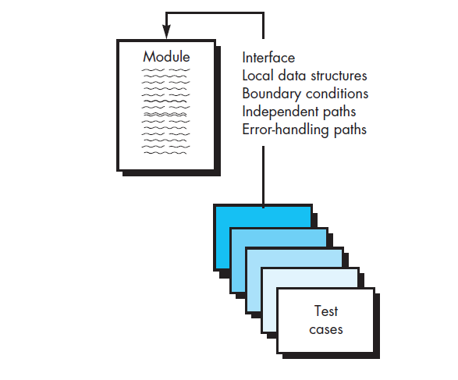
Unit Testing

Slide 68
Common errors found in unit testing
Incorrect arithmetic precedence
Mixed mode operations
Incorrect initialization
Inaccuracy
Incorrect symbolic representation of an expression

Slide 69
Boundary testing
Boundary testing is one of the most important unit testing tasks.
Software often fails at its boundaries.
That is, errors often occur when the n th element of an n -dimensional array is processed

Slide 70
Anti-bugging
A good design anticipates error conditions and establishes error-handling paths to reroute or cleanly terminate processing when an error does occur.

Slide 71
Unit test procedures
The design of unit tests can occur after source code has been generated.
A review of design information provides guidance for establishing test cases
Each test case is coupled with a set of expected results
Driver and stub modules has to be developed for each unit test

Slide 72
Driver & stub modules
Driver
driver is a dummy “main program” that accepts test-case data, and passes such data to the component to be tested, and prints relevant results.
Stubs serve to replace modules that are invoked by the component to be tested.
A stub or “dummy subprogram” uses the subordinate module’s interface,
do minimal data manipulation,
prints verification of entry,
returns control to the module undergoing testing.

Slide 73
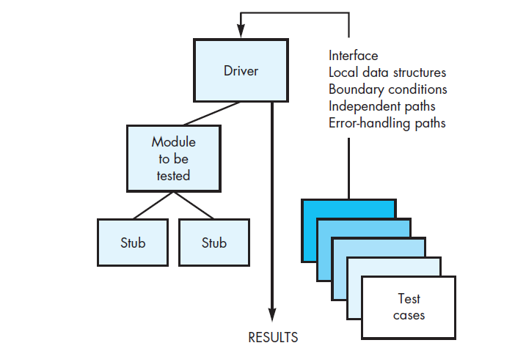

Slide 74
INTEGRATION TESTING

Slide 75
Introduction
Problems may arise when the modules are put together
This lead to the need of integration testing, even after unit testing
Problems caused
Data can be lost across an interface
one component can have an adverse effect on another
sub functions, when combined, may not produce the desired major function
individually acceptable imprecision may be magnified to unacceptable levels
global data structures can present problems.

Slide 76
Objective
Integration testing is a systematic technique for constructing the software architecture
At the same time it conducts tests to uncover errors associated with interfacing.
It takes unit-tested components and build a program structure that has been dictated by design.

Slide 77
Big-bang approach of integration
All components are combined in advance and the entire program is tested as a whole.
Problem
Errors are encountered
Correction is difficult
Complicated by the vast expanse of the entire program.
Solution
Incremental integration

Slide 78
Incremental integration
The program is constructed and tested in small increments.
Errors are easier to isolate and correct
Interfaces are more likely to be tested completely
A systematic test approach may be applied

Slide 79
Incremental integration testing strategies
Two types
Top down integration testing
Bottom up integration testing

Slide 80
TOP-DOWN INTEGRATION TESTING
It is an incremental approach to construct the software architecture.
Modules are integrated by moving downward through the control hierarchy,
Integration begins with the main control module (main program).
Modules that are subordinate and ultimately subordinate to the main control module are incorporated into the structure by
Depth-first
Breadth-first manner.

Slide 81
Depth first integration
It integrates all components on a major control path of the program structure.
Selection of a major path depends on application-specific characteristics.
Eg“ if we select left path,
components M1, M2 , M5 would be integrated first.
Next, M8 or M6 would be integrated.
Then, the central and right-hand control paths are built.

Slide 82
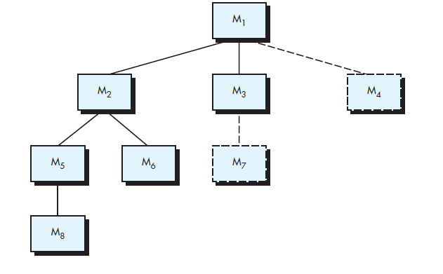
Depth first integration

Slide 83
Breadth first integration
incorporates all components directly subordinate at each level,
Moves across the structure horizontally.
Components M2, M3, and M4 would be integrated first.
The next control level, M5, M6, and so on,

Slide 84
Steps for top-down integration
The main control module is used as a test driver and stubs are substituted for all components directly subordinate to the main control module.
Depending on the integration approach selected subordinate stubs are replaced one at a time with actual components.
Tests are conducted as each component is integrated.
On completion of each set of tests, another stub is replaced with the real component.
Regression testing is conducted to ensure that new errors have not been introduced.

Slide 85
Advantages of top down integration testing
It verifies major control or decision points early in the test process.
decision making occurs at upper levels in the hierarchy and is encountered first.
If major control problems do exist, early recognition is essential.
Less complicated

Slide 86
Disadvantages
Problems arise if processing at low levels of hierarchy is necessary to test upper levels
3 choices
Delay the tests until stubs are replaced by actual modules
Develop stubs that perform limited functions that simulate the actual module
Integrate the s/w from bottom to top

Slide 87
BOTTOM UP INTEGRATION TESTING
It begins construction and testing with atomic modules
i.e., components at the lowest levels in the program structure
Since components are integrated from the bottom up,
the functionality provided by components subordinate to a given level is always available
the need for stubs is eliminated.

Slide 88
Steps of bottom up integration
Low-level components are combined into clusters that perform a specific software sub function.
A driver is written to coordinate test-case input and output.
The cluster is tested.
Drivers are removed and clusters are combined moving upward in the program structure.

Slide 89
Procedure
Components are combined to form clusters 1, 2, and 3.
Each of the clusters is tested using a driver
Components in clusters 1 and 2 are subordinate to M a .
Drivers D1 and D2 are removed and the clusters are interfaced directly to M a .
Similarly, driver D3 for cluster 3 is removed prior to integration with module Mb.
Both M a and M b will ultimately be integrated with component M c , and so forth.

Slide 90
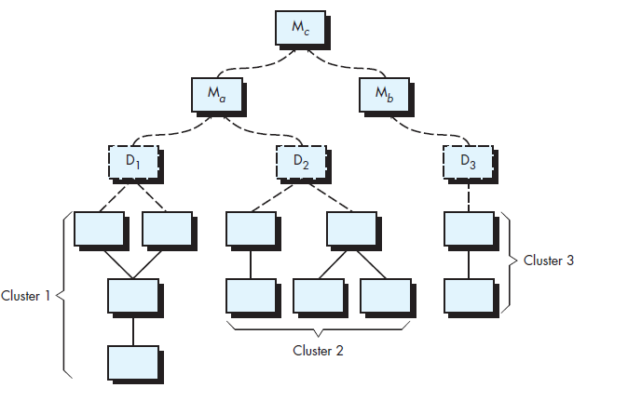

Slide 91
REGRESSION TESTING
Regression testing is an important strategy for reducing “side effects.” of integration
Each time a new module is added as part of integration testing, the software changes.
New data flow paths are established,
new I/O may occur,
new control logic is invoked.
These changes may cause problems with functions that previously worked flawlessly.
Regression testing is the re-execution of some subset of tests that have already been conducted
It ensure that changes have not propagated unintended side effects

Slide 92
Classes of test cases of regression testing
A representative sample of tests that will exercise all software functions.
•Additional tests that focus on software functions that are likely to be affected by the change.
Tests that focus on the software components that have been changed.

Slide 93
Smoke testing
Smoke testing is an integration testing approach that is commonly used when product software is developed.
It is designed as a pacing mechanism for time-critical projects,
allows the software team to assess the project on a frequent basis.

Slide 94
Activities of smoke testing
Software components that have been translated into code are integrated into a build.
A build includes
data files,
libraries,
reusable modules,
engineered components that are required to implement one or more product functions.
A series of tests is designed to expose errors that will keep the build from properly performing its function.
The intent should be to uncover “show-stopper” errors
The build is integrated with other builds, and the entire product is smoke tested daily.

Slide 95
Advantages
Integration risk is minimized
Smoke test is conducted daily
Show stopper errors are uncovered early
The quality of the end product is improved.
smoke testing uncover functional errors as well as architectural and component-level design errors.
if these errors are corrected early, better product quality will result.
Error diagnosis and correction are simplified.
Progress is easier to assess.

Slide 96
Strategic options
Selection of integration strategy depends on
Software characteristics
Project schedule
Generally selected strategy is sandwich testing
Couples top down & bottom up strategies
Uses top down tests for upper levels of program
Bottom up tests are applied on subordinates

Slide 97
When integration testing is conducted, tester must identify critical modules
Characteristics of critical modules
Addresses several software requirements
Has high level of control
Complex or error prone
Has definite performance requirements
They should be tested early
Regression test must focus on critical module functions

Slide 98
Integration test documentation
An overall plan for integration of the software and a description of specific tests is documented in a Test Specification.
This incorporates
a test plan
and a test procedure
Test plan describes the overall strategy of integration
Testing is divided into phases
Following tests are applied to these phases
Interface integrity
Functional validity
Information content
performance

Slide 99
Interface integrity
Internal & external interfaces are tested as each module is incorporated into the structure
Functional validity
Uncover the functional errors
Information content
Tests designed to uncover errors associated with local or global data structures
Performance
Tests designed to verify performance bounds established during software design

Slide 100
Test plan describes following
A schedule for integration
The development of overhead software
Start and end dates for each phase
Test environment and resources are
Unusual hardware configurations
Exotic simulators
Special test tools or techniques

Slide 101
Contents of test procedure
The order of integration
corresponding tests at each integration step are described.
A listing of all test cases
expected results are also included.

Slide 102
VALIDATION TESTING

Slide 103
Introduction
Validation testing begins at the culmination of integration testing,
It happens when
Individual components have been exercised,
the software is completely assembled as a package,
interfacing errors have been uncovered and corrected.
It focuses on
user-visible actions
user-recognizable output from the system.

Slide 104
Validation test succeeds when
software functions in a manner that can be reasonably expected by the customer
Reasonable expectations are defined in SRS document
It describes all user visible attributes of the software
SRS has a section called validation criteria
Information in this section forms the basis of validation testing

Slide 105
Validation test criteria
Software validation is achieved through a series of tests that demonstrate conformity with requirements.
A test plan outlines the classes of tests to be conducted,
Test procedure defines specific test cases that are designed
Test procedure ensure that
all functional requirements are satisfied,
all behavioral characteristics are achieved,
all content is accurate and properly presented,
all performance requirements are attained,
documentation is correct,
usability and other requirements are met

Slide 106
If a deviation from specification is uncovered,
a deficiency list is created.
A method for resolving deficiencies are established.

Slide 107
Configuration review or Audit
An important element of the validation process is a configuration review.
The intent of the review is to ensure that
all elements of the software configuration have been properly developed,
they are properly cataloged
They have the necessary detail to bolster the support activities.
The configuration review, is also called as Audit

Slide 108
SYSTEM TESTING
It is a series of different tests whose primary purpose is to fully exercise computer based system
Software is an incorporation of different s/m elements like
h/w
People
Information etc
System testing ensures that
the software together with these elements are working properly or not
Each tests in system testing have different purpose
All of them work to verify that system elements are properly integrated & they perform allocated functions

Slide 109
ALPHA & BETA TESTING
If software is developed as a product to be used by many customers, it is impractical to perform acceptance tests with each one
In this case, we use a process called alpha and beta testing
It uncover errors that only the end user seems able to find.

Slide 110
ALPHA TESTING
The alpha test is conducted at the developer’s site by a representative group of end users.
Testing is done in the presence of the developer
He records the errors and usage problems.
Alpha tests are conducted in a controlled environment.

Slide 111
BETA TESTING
The beta test is conducted at one or more end-user sites.
the developer generally is not present.
It is a “live” application of the software in an environment that cannot be controlled by the developer.
The customer records all problems that are encountered during beta testing
He reports these to the developer at regular intervals.
Software engineers make modifications & then prepare for release of software product to the entire customer base

Slide 112
ACCEPTANCE TESTING
When custom software is built for one customer, a series of acceptance tests are conducted to enable the customer to validate all requirements.
Acceptance tests are conducted by the end user rather than software engineers
They can be conducted over a period of weeks or months,
They uncovers cumulative errors that might degrade the system over time.

Slide 113
RECOVERY TESTING
A software must recover from faults and resume processing within a specified time
system must be fault tolerant
faults must not cause overall system function to cease.
a system failure must be corrected within a specified period of time
Recovery testing is a system test that forces the software to fail in a variety of ways

Slide 114
It verifies that recovery is properly performed.
If recovery is automatic
Re-initialization,
check pointing mechanisms,
data recovery,
Restarting etc are evaluated for correctness.
If recovery requires human intervention,
the mean-time-to-repair (MTTR) is evaluated to determine whether it is within acceptable limits.

Slide 115
SECURITY TESTING
Security testing attempts to verify that protection mechanisms built into a system will protect it from improper penetration
Any computer-based system that manages sensitive information are prone to improper or illegal penetration.
Types of penetration
hackers who attempt to penetrate systems for sport,
disgruntled employees attempt to penetrate for revenge,
dishonest individuals attempt to penetrate for illicit personal gain.

Slide 116
During security testing, tester plays the role of individuals who desires to penetrate the system
Tester attempts to acquire passwords through clerical means
He attacks the system with customer s/w, which breaks the defenses
Purposely cause system errors to penetrate through recovery
Browse through insecure data, to find the key to system entry

Slide 117
STRESS TESTING
Stress tests are designed to confront programs with abnormal situations.
It is done to identify
“How high can we crank the system before it fails?
Stress testing executes a system in a manner that demands resources in abnormal quantity, frequency, or volume.

Slide 118
special tests may be designed that generate 10 interrupts per second,
input data rates may be increased to determine how input functions will respond
test cases that require maximum memory or other resources are executed
test cases that may cause thrashing in a virtual operating system are designed,
test cases that may cause excessive hunting for disk-resident data are created.
Essentially, the tester attempts to break the program by giving it maximum stress

Slide 119
SENSITIVITY TESTING
It is a variation of stress testing
Sensitivity testing attempts to uncover data combinations within valid input classes that may cause instability or improper processing.

Slide 120
PERFORMANCE TESTING
Performance testing is designed to test the run-time performance of software within the context of an integrated system.
It occurs throughout all steps in the testing process.
Even at the unit level, the performance of an individual module may be assessed as tests are conducted.
the tester can uncover situations that lead to degradation and possible system failure.

Slide 121
BLACK BOX TESTING

Slide 122
Introduction
Black box testing is an approach used to systematically design test cases for testing
Test case is a triplet [I,S,R]
I is the data input to the program under test
S is the state of the program at which the data is to be input
R is the result expected to be produced by the program
This is in contrast to testing using some random i/p values

Slide 123
Features
Test cases are designed using the functional specification of the s/w
Designing is solely based on the analysis of I/O values
Ie functional behavior
Does not require knowledge of internal structure of the program
It is also called as functional testing

Slide 124
Methods for black-box testing
2 main approaches
Equivalence class partitioning
Boundary value analysis

Slide 125
Equivalence class partitioning
Domain of input values to the program under test is partitioned into a set of equivalence classes
Partitioning is done in such a way that, for every i/p belonging to the same class, program behaves similarly

Slide 126
Guidelines for designing equivalence class
If input values to the system is specified by a range of values
Define one valid equivalence class & 2 invalid equivalence classes
Eg: input values are to be in range [1,10]
Valid equivalence class [1,10]
Invalid equivalence class
[-∞,0]
[11,+ ∞]

Slide 127
If the input data assumes values from a set of discrete members of some domain
Define one equivalence class for valid input values & another equivalence class for invalid i/p values
Eg: valid equivalence class {A,B,C}
Invalid : U-{A,B,C}

Slide 128
Black-box test suite designing
After finding the equivalence classes, take one member from each equivalence class, to generate a test suite

Slide 129
Example 1
Question
For a software that computes the square root of an input integer which can assume values in the range of 0 to 5000, determine the equivalence classes & the black box test suite

Slide 130
Solution
Equivalence classes = 3 classes
Valid class= {0,5000} ➔set of integers in range
Invalid class
{-∞,-1} ➔set of negative integers
{5001,+ ∞} ➔ set of integers > 5000
Test suite : {-5,250,6000}

Slide 131
Example 2
Design the black-box test suite for the following program.
The program computes the intersection point of two straight lines and displays the result. It reads two integer pairs (m1, c1) and (m2, c2) defining the two straight lines of the form y=mx + c.

Slide 132
Solution
The equivalence classes are the following:
Parallel lines (m1=m2, c1≠c2)
Intersecting lines (m1≠m2)
Coincident lines (m1=m2, c1=c2)
test suit
{(2, 2) (2, 5), (5, 5) (7, 7), (10, 10) (10, 10)}

Slide 133
Boundary value analysis
A type of programming error frequently occurs at the boundaries of different equivalence classes of inputs.
The reason behind such errors
Programmers often fail to see the input values that lie at the boundary of the different equivalence classes.
This happens due to improper use of < instead of <= abs vice versa

Slide 134
Boundary value analysis based test suit design
This involve designing test cases using the values at the boundaries of different equivalence classes
This is applicable only to equivalence classes having a range of values
Eg: if an equivalence class contains integers in range [1,10]
Boundary value test suit: {0,1,10,11}

Slide 135
Example
For a function that computes the square root of integer values in the range of 0 and 5000, determine the boundary value test suite

Slide 136
Solution
3 equivalence classes
{0,5000} ➔ set of integers within the range
{-∞,-1} ➔set of negative integers
{5001,+ ∞} ➔ set of integers > 5000
Boundary value test suite:
{-1,0,5000,5001}

Slide 137
Steps of black box test suite design
Examine input & output values of the program
Identify the equivalence classes
Design equivalence class test cases, by picking up one representative value from each class
Design boundary value test cases, if any equivalence class is a range of values
Then include values at the boundaries of such classes in the test suite

Slide 138
WHITE BOX TESTING

Slide 139
Introduction
Test cases are designed based on the internal structure of the program
Also called structural testing
test cases are designed based on the analysis of code

Slide 140
Strategies of white box testing
Fault based testing
This strategy targets to detect certain types of faults
These faults constitute fault model
Eg: mutation testing
Coverage based testing
This strategy attempts to execute certain elements of a program
Eg: statement coverage
Branch coverage
Multiple condition coverage
Path coverage based testing

Slide 141
Testing criterion for coverage based testing
Set of specific program elements that a testing strategy targets to execute is called testing criterion of the strategy
Eg: if testing strategy requires to execute all stmts of the pgm, at least once then test criterion of the strategy is statement coverage

Slide 142
Stronger Vs weaker testing
A strategy is said to be stronger than another strategy
If the stronger testing strategy covers all program elements covered by weaker testing strategy and,
The stronger strategy additionally covers at least one program element that is not covered by the weaker strategy

Slide 143
Complementary testing strategy
When none of the 2 testing strategies fully covers the program elements exercised by the other, then two are called complementary testing strategies
A and B are complementary testing strategies if some elements of A are not covered by B and vice versa

Slide 144
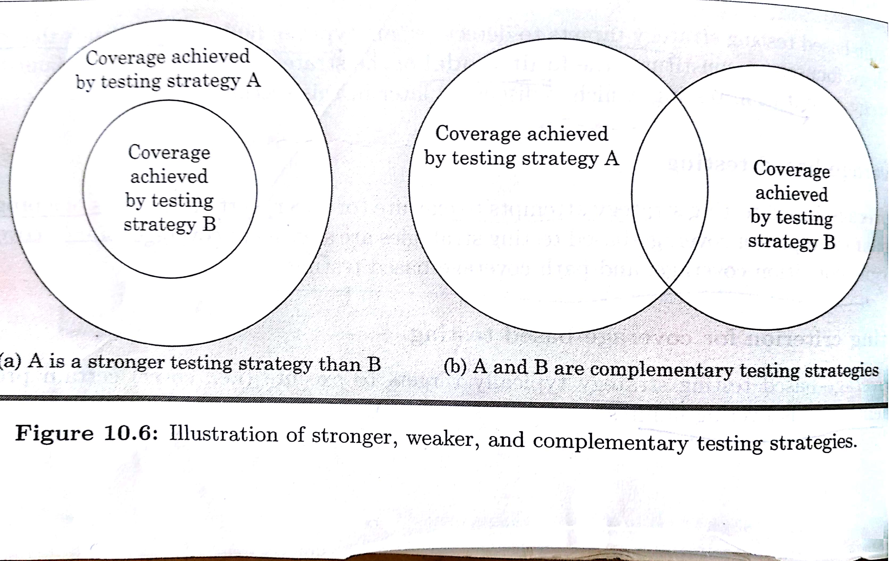

Slide 145
Statement coverage
Aims to design test cases which executes every statement in a program at least once
The idea behind statement coverage
Unless a statement is executed, there is no way to determine whether an error exists in that statement
Weakness
Executing a statement once and observing that it behaves properly for one i/p value give no guarantee that it will behave correctly for all i/p values

Slide 146
Example
While(x!=y)
{
If(x> y) then
x=x-y;
else y=y-x;
}
return x;

Slide 147
To design test cases for the statement coverage,
the conditional expression of the while stmt needs to be made true
and the conditional expression of the if stmt needs to be made both true and false
Test cases
{(x=3,y=3),(x=4,y=3),(x=3,y=4)}
The above test case allows the execution of every stmt at least once

Slide 148
Branch coverage
A test suite satisfies branch coverage
if it makes each branch condition in the program to assume true and false values in turn
In branch coverage,
Each branch in the CFG representation of the program must be taken at least once, when the test suite is executed
Also called as edge testing

Slide 149
Example
While(x!=y)
{
If(x> y) then
x=x-y;
else y=y-x;
}
return x;

Slide 150
Test suite
{(x=3,y=3),(x=3,y=2),(x=4,y=3),(x=3,y=4)}
Branch testing is stronger than stmt testing

Slide 151
Multiple Condition Coverage
MCC test cases are designed to make each component of a composite expression to assume both true and false values
Consider the conditional expression
((c1 and c2) or c3).
A test suite will achieve MC coverage if all the component conditions c1,c2 and c3 are each made to assume both true and false values

Slide 152
MC coverage testing is stronger than branch testing
For a composite conditional expression of n components, (2)n test cases are required for multiple condition coverage
So MC coverage is practical only if n is small

Slide 153
Path coverage
A test suite achieves path coverage if it executes each linearly independent paths at least once
A linearly independent path is defined in terms of CFG of a program

Slide 154
CFG
A CFG is a directed graph consisting of a set of nodes and edges (N,E) such that
n€ N corresponds to a unique program stmt
Edge exist b/w two nodes if control can transfer from one node to the other

Slide 155
Path
Path through a program is any node and edge sequence from the start node to a terminal node of the CFG

Slide 156
Linearly independent set of paths
A set of paths for a given program is linearly independent if
each path in the set introduces at least one new edge that is not included in any other path in the set

Slide 157
Mutation Testing
It is a fault based testing technique
Designed to detect specific types of faults in a program
Program is first tested using the initial test suite, which is designed based on other white box testing strategy
After initial testing, mutation testing is taken up

Slide 158
Idea behind mutation testing
Make few arbitrary changes to a program at a time
Mutated pgm
Each time when a program is changed, then the resultant pgm is called mutated pgm
The change effected is called mutant
Mutation makes specific errors to the pgm
Randomly deleting a pgm stmt
Deleting a variable definition
Changing the arithmetic operator etc

Slide 159
A mutant may or may not cause an error in the pgm
If the mutant does not cause an error in the pgm, then original pgm and the mutated pgm is called equivalent program

Slide 160
Advantages
Generation of mutants can be automated
This is done by predefining a set of primitive changes that can be applied to pgm
Disadvantage
Computationally expensive
Mutation testing involves generating a large no: of mutants
Each mutant needs to be tested with the full test suite
Not suitable for manual testing

Slide 161
BASIS PATH TESTING

Slide 162
Introduction
Basis path testing is a white-box testing technique proposed by Tom McCabe
This method enables the test-case designer to derive a logical complexity measure of a procedural design
This measure is used as a guide for defining a basis set of execution paths.
Test cases derived are guaranteed to execute every statement in the program at least one time during testing.

Slide 163
Flow graph notation
The flow graph depicts logical control flow using the notation
Each circle, called a flow graph node, represents one or more procedural statements.
The arrows on the flow graph, are called edges or links, represent flow of control
Areas bounded by edges and nodes are called regions.
When counting regions, we include the area outside the graph as a region

Slide 164
Predicate node
a separate node is created for each of the conditions a and b in the statement
IF a OR b.
Each node that contains a condition is called a predicate node

Slide 165
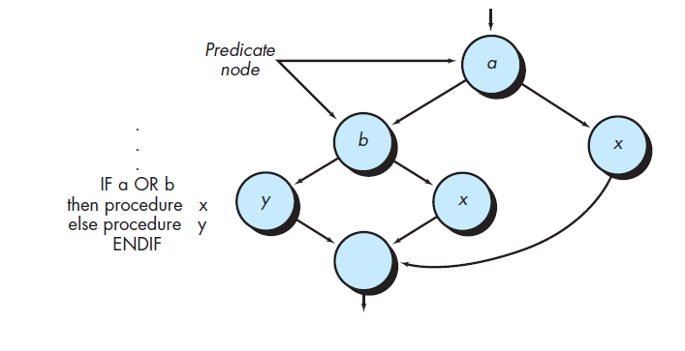

Slide 166
Independent program paths
An independent path is any path through the program that introduces at least one new set of processing statements or a new condition.

Slide 167
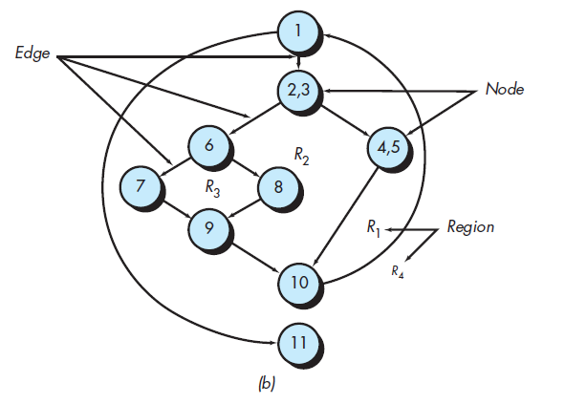
Example
Independent paths
Path 1: 1-11
Path 2: 1-2-3-4-5-10-1-11
Path 3: 1-2-3-6-8-9-10-1-11
Path 4: 1-2-3-6-7-9-10-1-11

Slide 168
Following path is not an independent path
1-2-3-4-5-10-1-2-3-6-8-9-10-1-11
it is simply a combination of already specified paths and does not traverse any new edges.

Slide 169
Cyclomatic complexity
the number of independent paths in the basis set of a program = cyclomatic complexity of program
This provides an upper bound for the number of tests that must be conducted to ensure that all statements have been executed at least once.

Slide 170
Deriving test cases
Using the design or code draw the CFG
Determine cyclomatic complexity of the CFG
Determine the basis set of linearly independent paths
Prepare a test case that will force execution of each path in the basis set

Slide 171
Preparing test case
Data should be chosen so that conditions at the predicate nodes are appropriately set as each path is tested.
Each test case is executed and compared to expected results
Once all test cases have been completed,
the tester can be sure that all statements in the program have been executed at least once.

Slide 172
CYCLOMATIC COMPLEXITY

Slide 173
Introduction
Cyclomatic complexity of a program is a measure of psychological complexity or the level of difficulty in understanding the program
It is also known as structural complexity
It gives internal view of the code
It provides us the upper bound for no: of tests that must be conducted to ensure that
all statements have been executed at least once
Every condition has been executed on its true and false side

Slide 174
McCabes cyclomatic metric
Given a control flow graph G of a program, the cyclomatic complexity V(G) can be computed as
V(G)= E-N+2P
E➔ no : of edges of graph
N➔ no: of nodes of the graph
P➔ no: of connected components of the graph

Slide 175
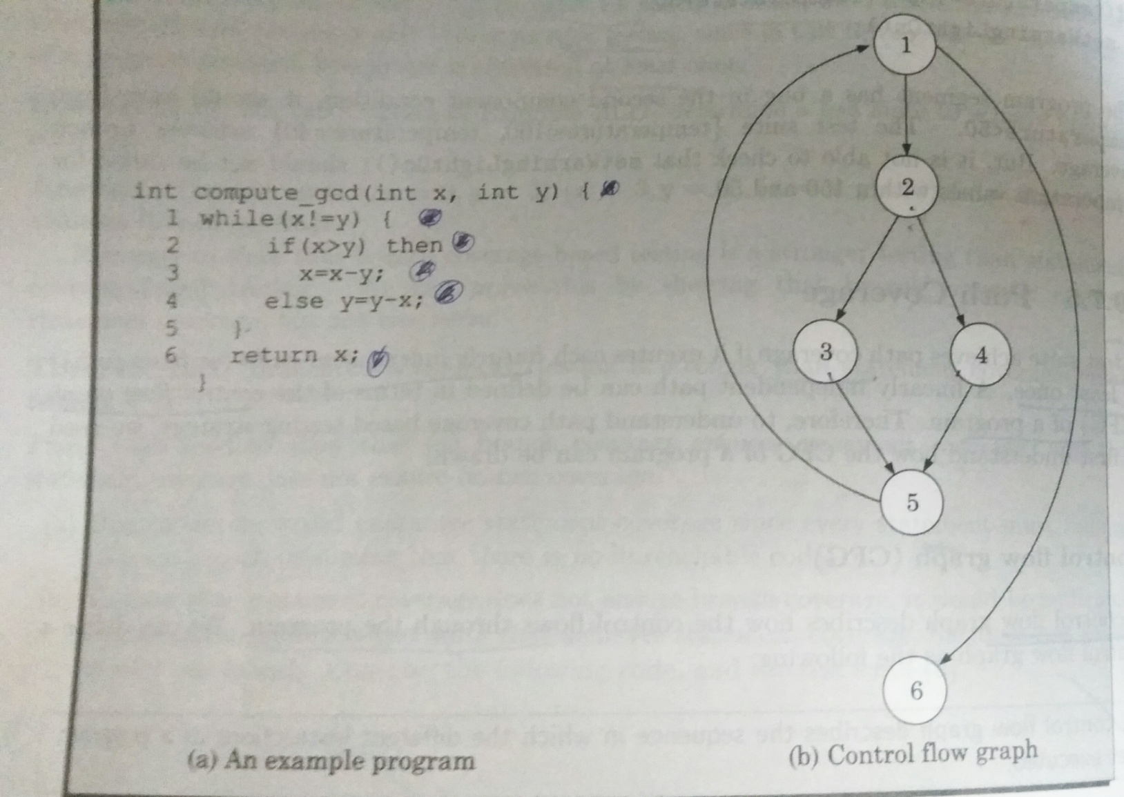
Control Flow graph of a program

Slide 176
Role of P
Connected component P has vital role in calculating cyclomatic complexity
In most cases P=1
Coz every flow graph has a unique entry and exit nodes
All nodes are reachable from entry node
Exit nodes are reachable from all the other nodes
This will result in flow graph with P=1

Slide 177
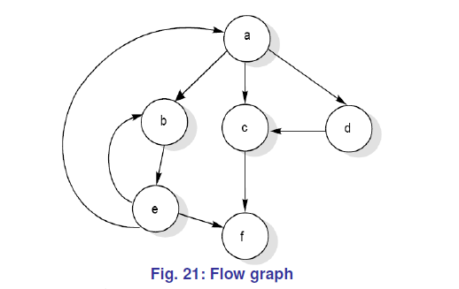
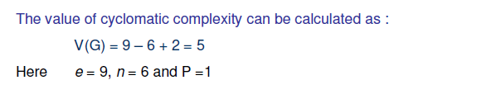
Example

Slide 178
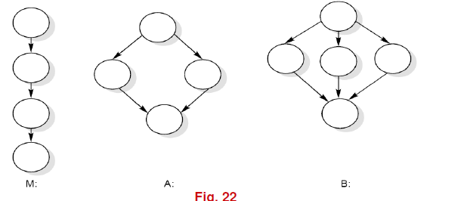
Cases when P!=1
P!=1 can be used to calculate the complexity of a collection of programs
Eg: heirarchical nest of subroutines
M➔ main program
A and B➔ subroutines of M

Slide 179
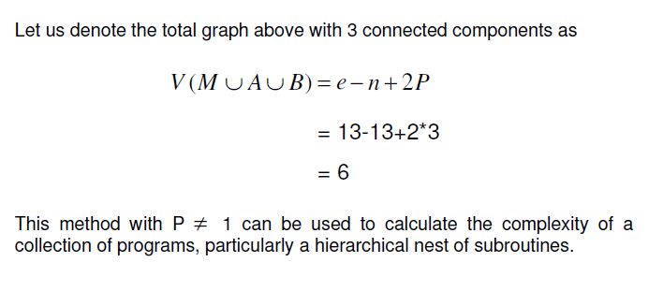

Slide 180
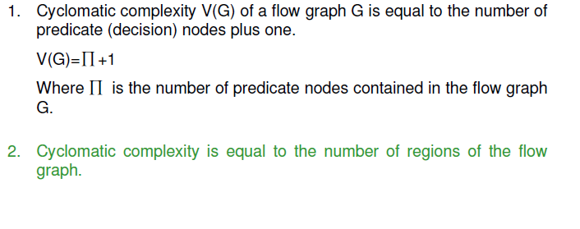
Alternate methods to calculate cyclomatic complexity

Slide 181
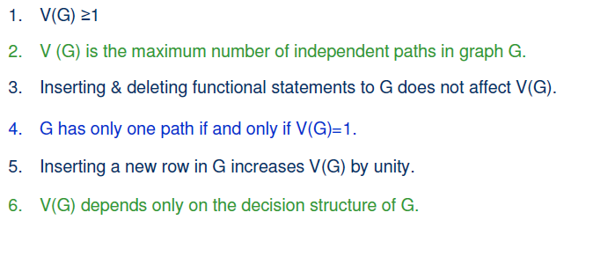
Properties of cyclomatic complexity

Slide 182
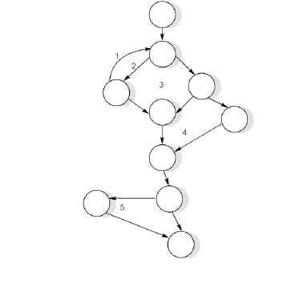
Example 2

Slide 183
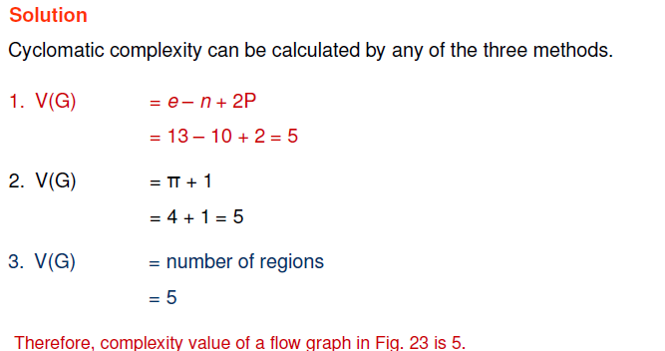
Solution

Slide 184
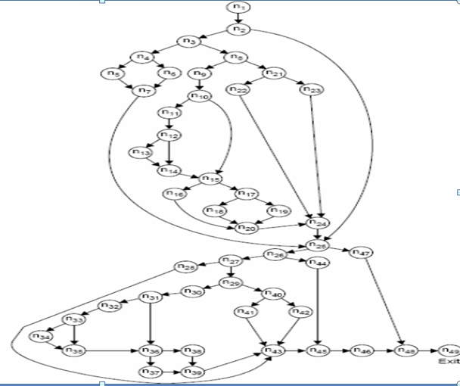
Example 3

Slide 185
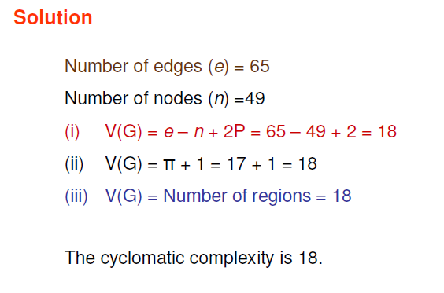
Solution

Slide 186
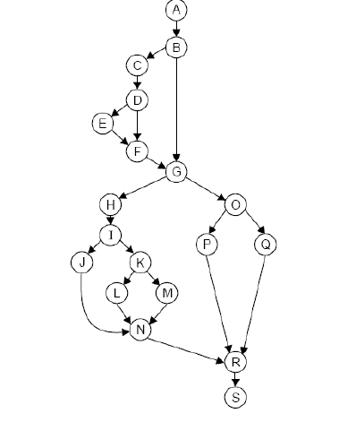
Example 4

Slide 187
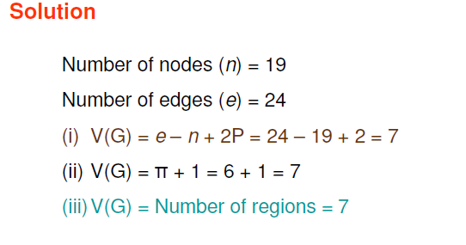
Solution

Slide 188
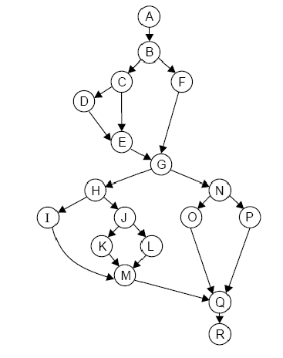
Example 5

Slide 189
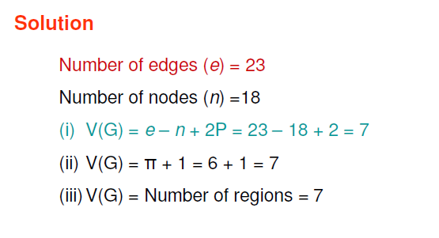
Solution

Slide 190
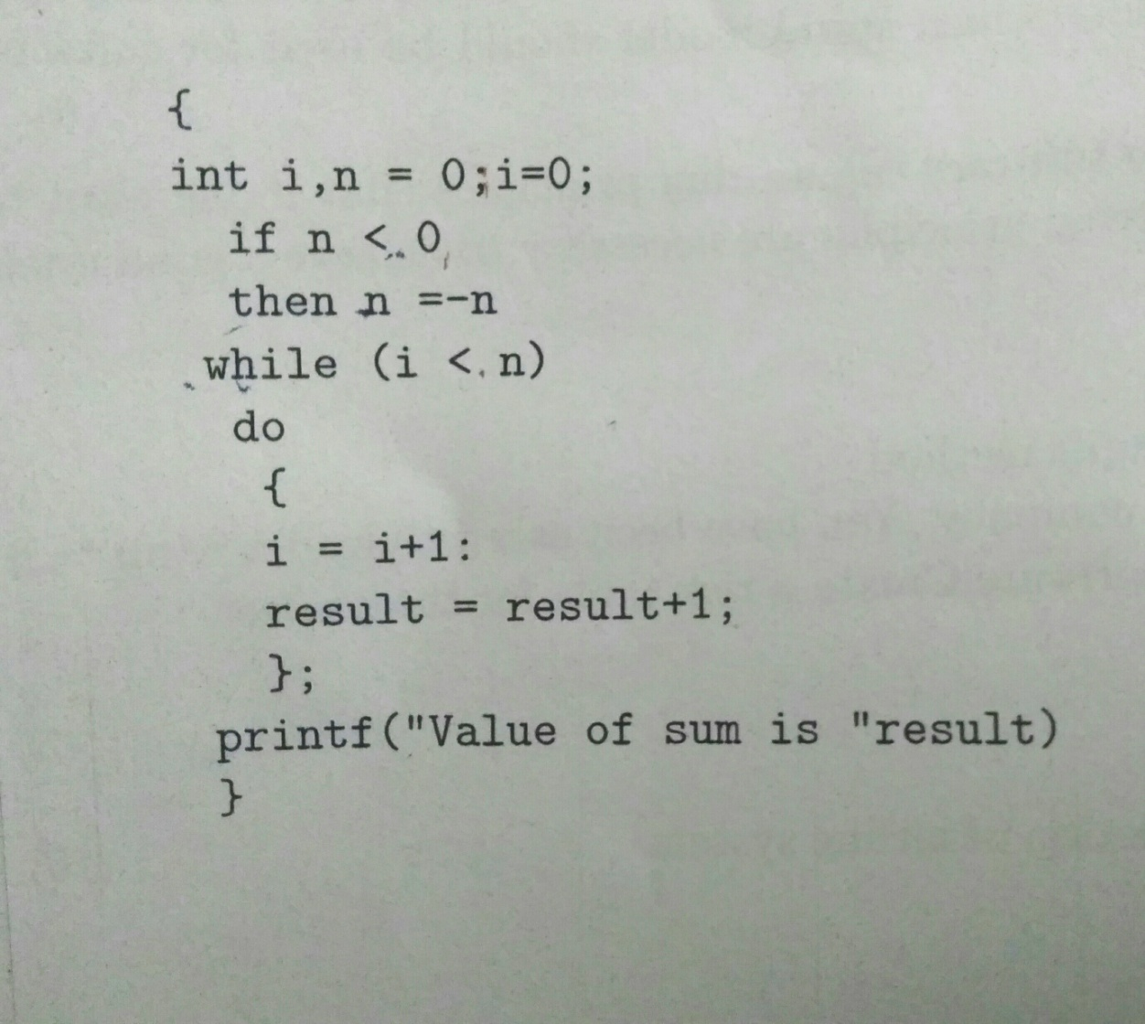
Complexity calculated from programs
Program 1

Slide 191
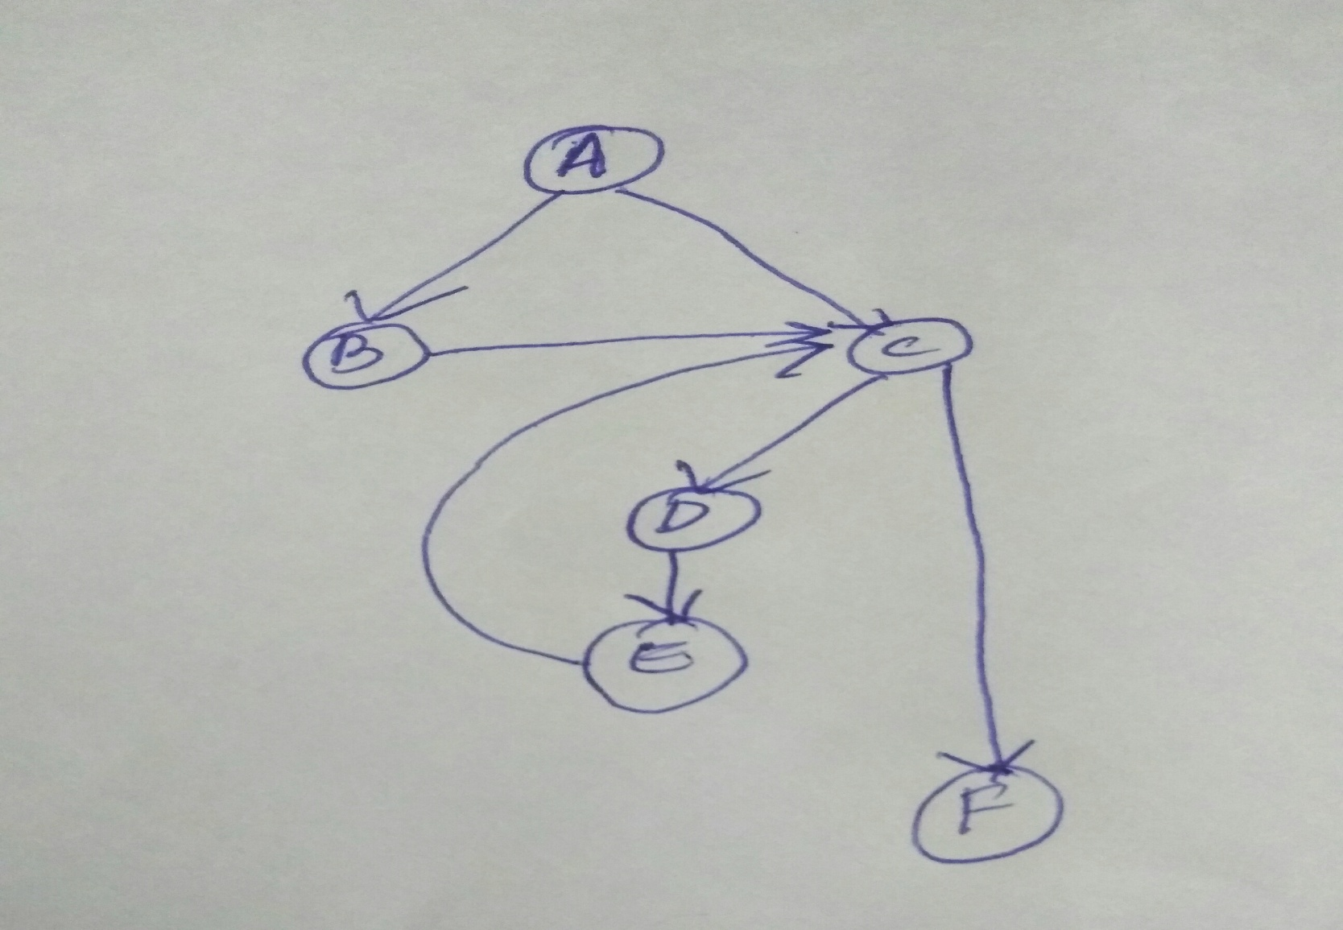
CFG of the program

Slide 192
Complexity of the program
Method 1: E-N+2P
E➔7
N➔6
P=1
Complexity: 7-6+2=3
Method 2
No: of decisions:2
Complexity: 2+1=3
Method 3
No: of regions=3

Slide 193
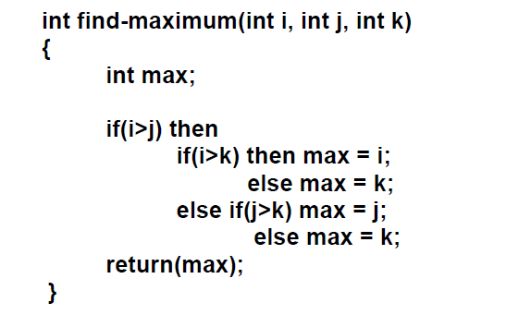
Sample questions

Slide 194
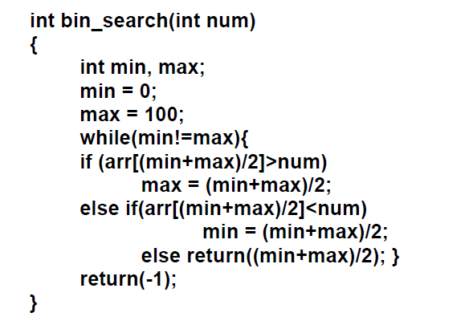

Slide 195
